Slide 1


Slide 2

Real Education Online
Socheton Academic CARE
Common Features and Benefits of Socheton Academic care

Slide 3
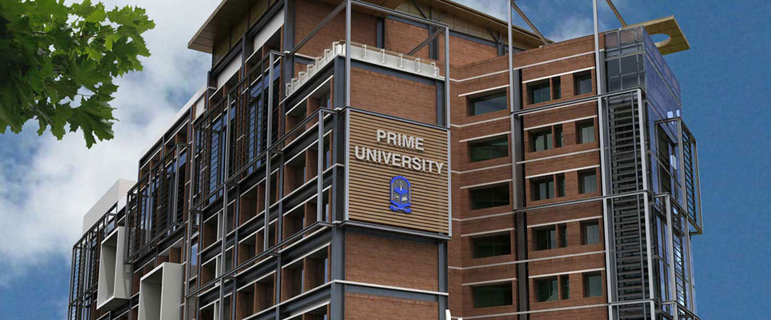


vvv
Our Service Area

Slide 4

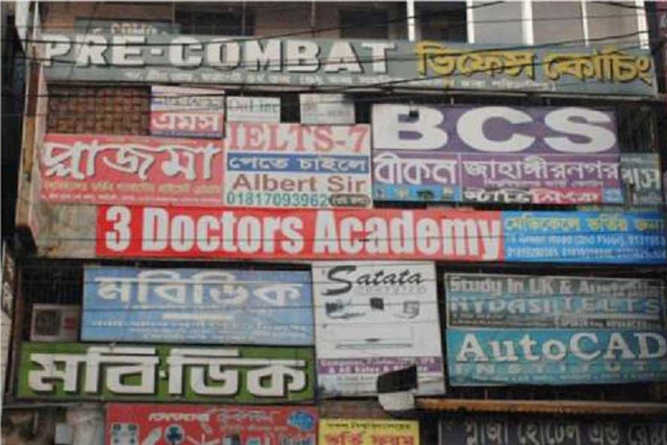
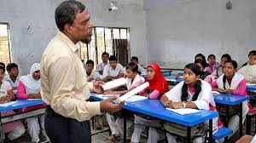
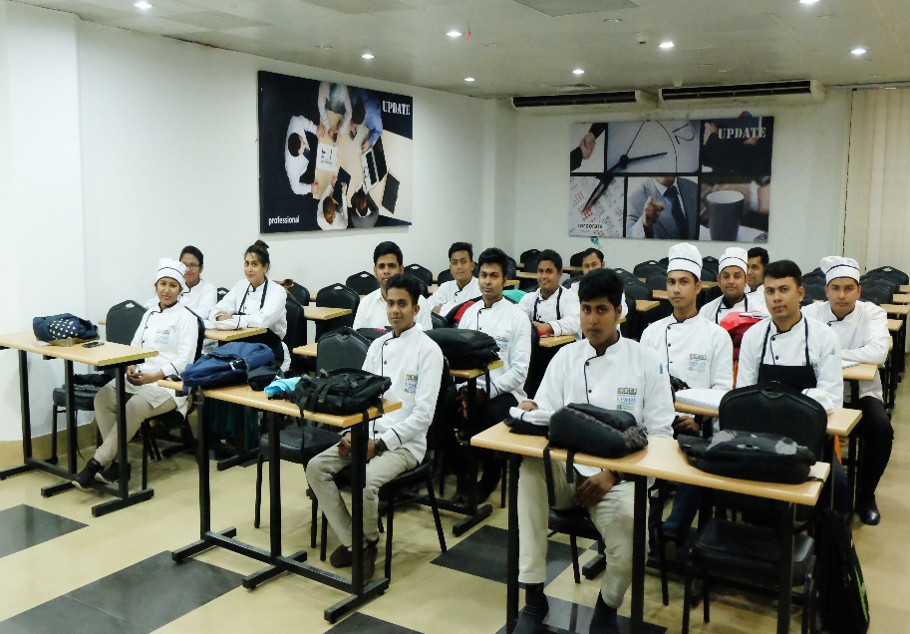


Slide 5
What We Serve
Full Online Classroom Set Up for Technical Training and Academic Teachers (Hardware Infrastructure)
An automated online live classroom activities like real time set up (Software)
Feasibility Study for Academic class, Training, Technical session context of Virtual Live Exam, Class, Homework and result publications like as real time
Easy Platform based Payment Service for Technical Training Centers, school, college, university, organizations, NGOs and others
Smooth internet service for class conduct
Low frequency internet class service for students

Slide 6
Why Socheton ?
Comfort at home
Only 80 MB- 120 MB costing Per Class
120 min continuous class and Easy to connect like live class
Comfortable with 2G, 3G and 4G from any place of Bangladesh.
Comfortable Home work and classwork submission
Online exam and immediate result
Clear sound and teacher live communication like real classroom
Not to face Traffic in COVID-19
Standard course fees and institution charge
Different Trainers Teachers from renowned institutes, colleges and schools
Advance with study at lockdown time..
Benefits for Students

Slide 7
Why Socheton ?
50 student batch at a time
1000’s of students in one platform
Easy to start class and No interruptions during class
Clear student voice and their communication sound
Standard online classroom set up
No hassle for class conduction like real-time.
Automated recording for You tube and facebook group.
Smooth payment from student and teachers
Not like other online based free services
Easy to handle homework and exam online
5-10 batch in a day and No time limit for batch start
Comfortable for CORONA lockdown time in Bangladesh.
Benefits for Teachers

Slide 8
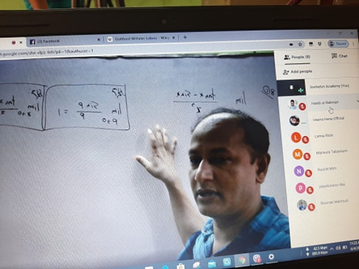
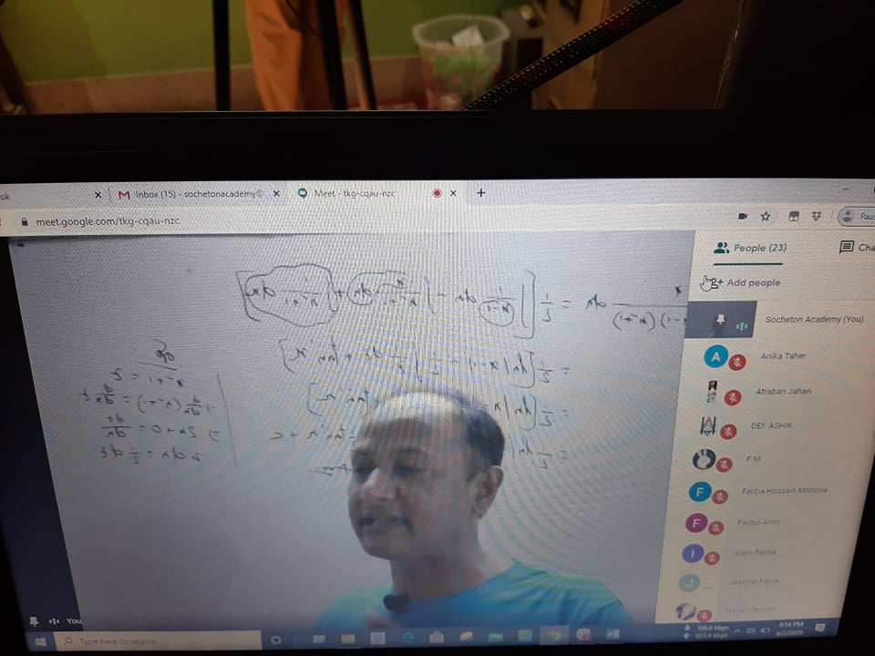
Jessore, Rangpur, Dhaka And CTG Combined Class
Our Ongoing Class Project
Sylhet, Barishal, Mymensing and Sherpur District Student Teaching (Math) Transmission

Slide 9
How We works?
Equipment And System Installation by Teachers/Institutions
Teacher’s Personal Students
Only Monthly Service Charge
Monthly Charge for Per student per class
All function conducted by Socheton and pay teacher per student basis as other coaching centers (Condition Applied)

Slide 10

Contact
Head Office
Abu Jubayer
CEO, Socheton Academic Care
28, Kawran Bazar, Dhaka-1215.
Mobile : 01711 459 532
Email: jubayer.ceo@socheton.com
Web: www.socheton.com
Virtual Campus (Dhanmondi)
Md. Borhan Udding
Campus President
Dhanmondi Virtual Campus
M: +88 01711 978 658
Email: borhan.vcampus2@socheton.com
Web: www.socheton.com

Slide 11
Thank You

